Slide 1
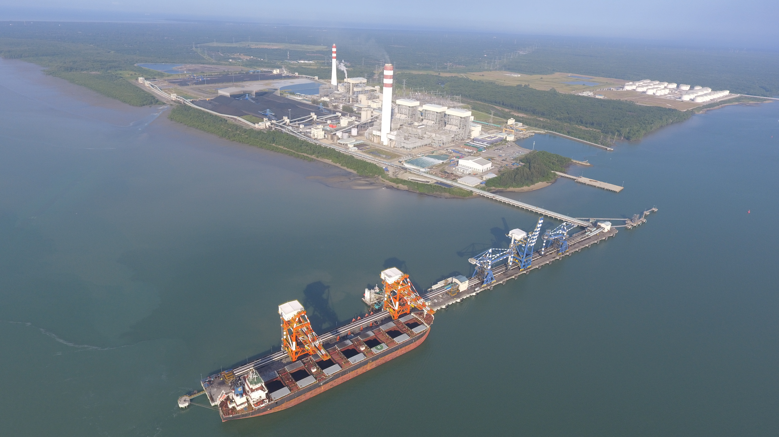
Step into Next Country
Exploring a potential market in a new country by data analysis

Slide 2
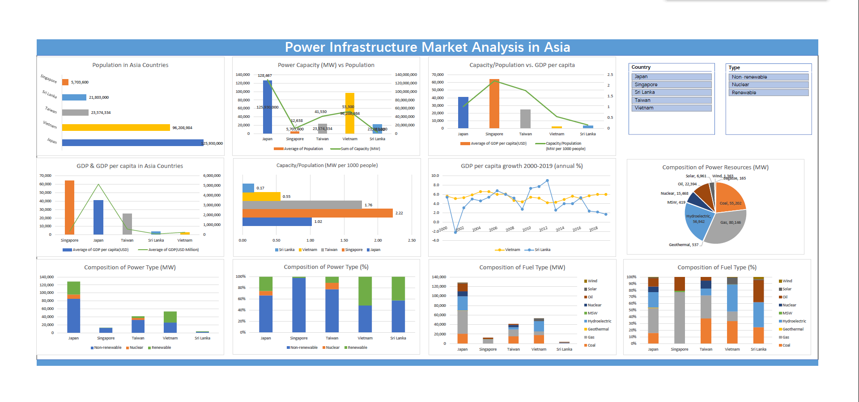
Dashboard Overview

Slide 3
Common Biometric Recognition Used in Daily Life
Content
Problem Definition
Data Collection
Data Preparation
Data Analysis & Visualization
Findings
Conclusion
Q & A

Slide 4
Problem Definition
Problem Definition
Business Scenario:
As a regional infrastructure construction company, my former employer plays an important role in Power Station Construction in Singapore, Malaysia, and Indonesia.
Since the power grid in these 3 countries are highly developed, there will not be many new projects in future.
So as marketing team, we would like to explore the Market Potential in South Asian Countries in Power Infrastructure.
Problem:
To explore potential market in a new country.
=>Potential Market = Demand is not fully met
=>Existing Power Generating Capacity is below Demand
=>Which Country facing Shortage of Power Generating Capacity?
<=Problem to solve

Slide 5
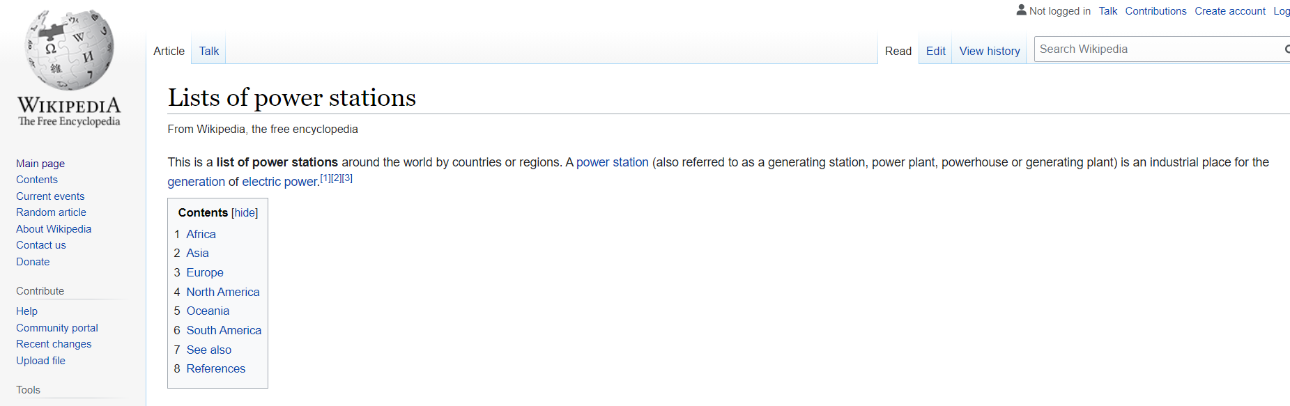
Data Collection
Data Collection
Problem:
Which Country facing Shortage of Power Generating Capacity?
=> What are the data to look for to solve this problem?
=>Existing Power Generating Capacity in respective countries.
Data Resource:
Wikipedia- Lists of power stations: https://en.wikipedia.org/wiki/Lists_of_power_stations

Slide 6
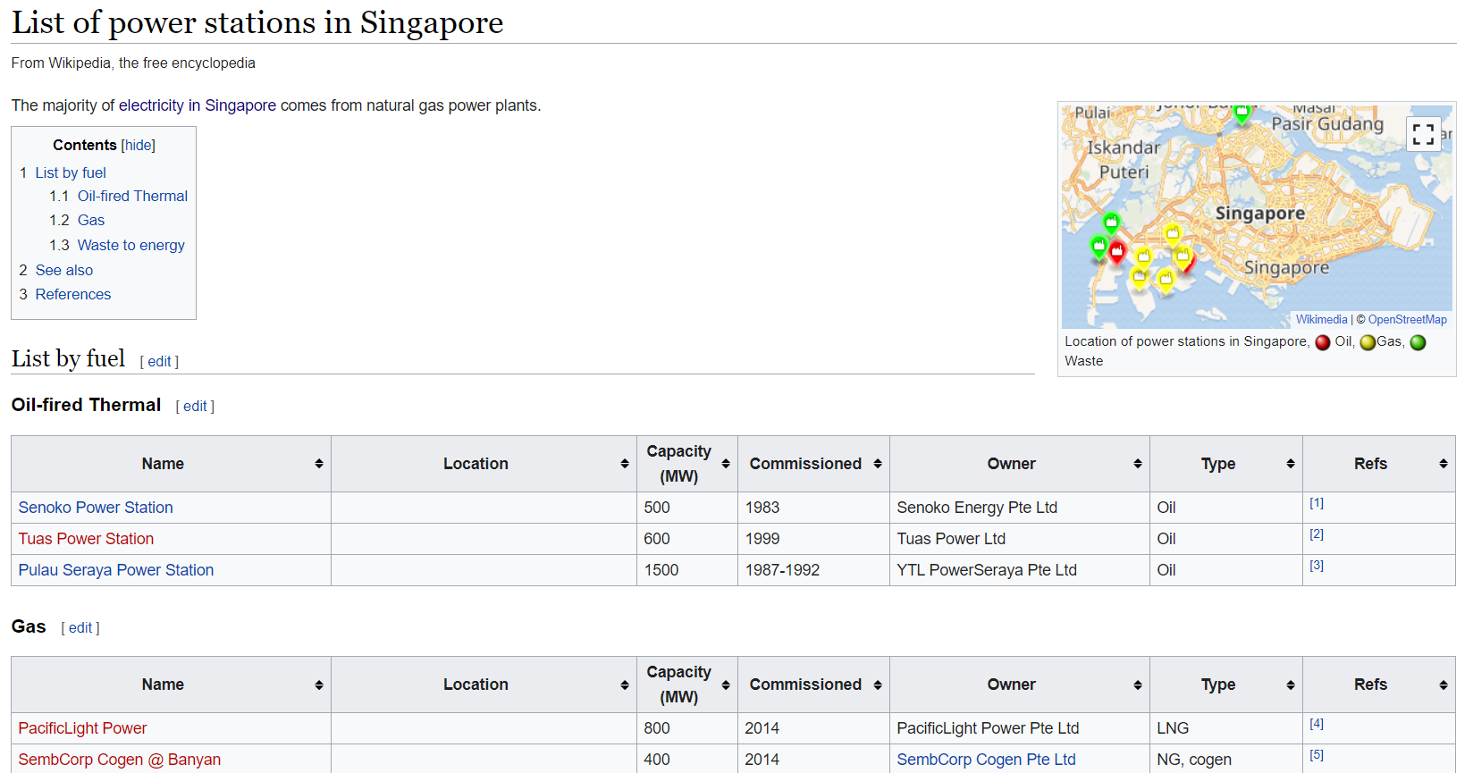
Data Collection
Data Collection
Data Resource:
Wikipedia- Lists of power stations: https://en.wikipedia.org/wiki/Lists_of_power_stations

Slide 7



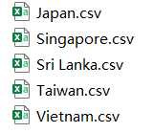
Data Collection
Data Collection
Data Resource:
Wikipedia- Lists of power stations: https://en.wikipedia.org/wiki/Lists_of_power_stations
Countries to look for data:
Developed Country/Region: Singapore, Japan, Taiwan
Developing Country: Vietnam, Sri Lanka
Metrics to look for:
Population
GDP & GDP per capita
Existing Power Station Name;
Existing Power Station Country;
Existing Power Station Capacity;(MW=Mega Watt)
Existing Energy Type;(Non-Renewable/Renewable/Nuclear)
Existing Fuel Type;(Oil/Gas/Coal/Wind/Hydro/Solar etc.)
Data Collection Procedure

Slide 8


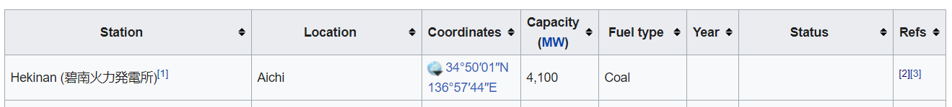


Data Preparation
Data Preparation
Singapore
Taiwan
Japan
Sri Lanka
Vietnam

Slide 9
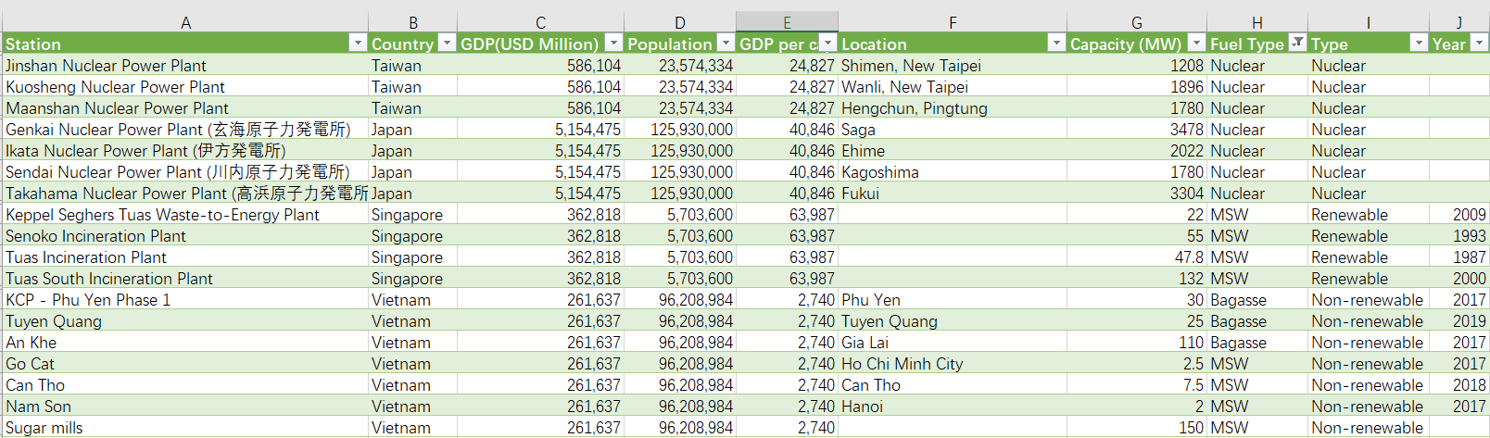
Data Preparation
Data Preparation
Master List-List of Power Stations in Asia

Slide 10
Data Analysis & Visualization
Data Analysis & Visualization
Question Analyzed:
What are the Population Distribution among these 5 countries?
What are the respective GDP & GDP per capita in these 5 countries? Which one could represent the Development Level of a country?
Does individual citizen have enough power supply? What is the Occupancy Rate of Power Generating Capacity for individual?
As Vietnam & Sri Lanka are still developing countries, currently they might not need as much Power Generating Rate as developed countries with respect to their Development Level. So, are they really in shortage of Power Generating Capacity in this stage? Which one has more market potential?
Is Sri Lanka developing well compared to Vietnam? What are their annual growth rate in GDP per capita?
=>Problem Solved

Slide 11
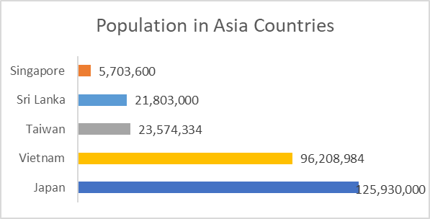
Findings
Findings
Which Country facing Shortage of Power Generating Capacity?
Question: 1. What are the Population Distribution among this 5 countries?
Answer:

Slide 12
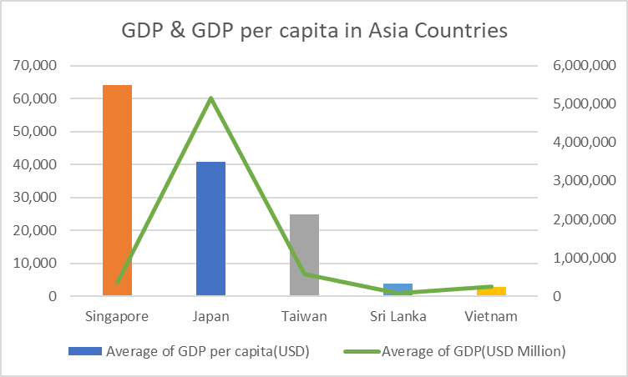
Findings
Findings
Which Country facing Shortage of Power Generating Capacity?
Question: 2. What are the respective GDP & GDP per capita in these 5 countries? Which one could represent the Development Level of a country?
Answer:
Finding : GDP per capita could represent the Development Level of a country
Developed Countries: Singapore, Japan, Taiwan
Developing Countries: Sri Lanka, Vietnam

Slide 13
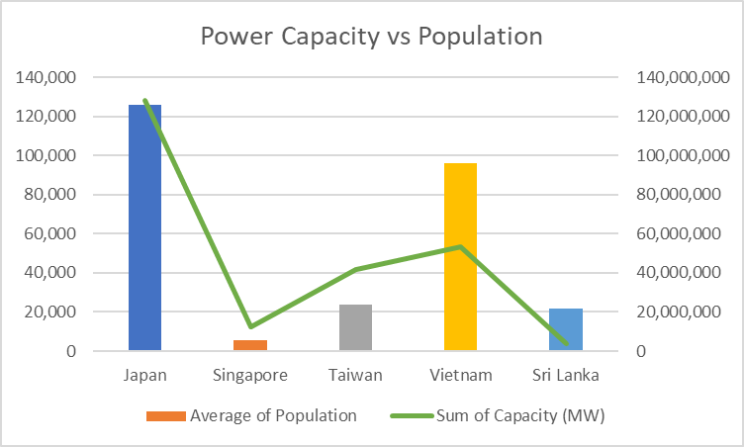
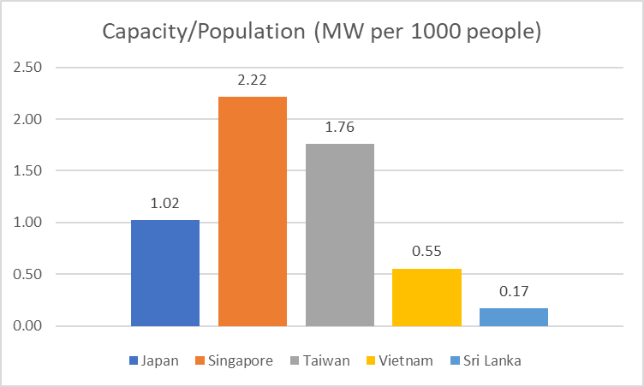
Findings
Findings
Which Country facing Shortage of Power Generating Capacity?
Question: 3. Does individual citizen have enough power supply? What is the Occupancy Rate of Power Generating Capacity for individual?
Answer:
Finding :
Developed Country: Capacity covers the demand from individual citizen;
Developing Countries: Capacity is under the demand by each people.
=> In long term, more Power Station are to be constructed to meet the demand from individual citizen. There are long-term market potential in both Vietnam & Sri Lanka.
<=Problem partially solved

Slide 14
Findings
Findings
Which Country facing Shortage of Power Generating Capacity?
Finding :
In long term, more Power Station are to be constructed to meet the demand from individual citizen. There are long-term market potential in both Vietnam & Sri Lanka.
=> Question: 4. As Vietnam & Sri Lanka are still developing countries, currently they might not need as much Power Generating Capacity as developed countries with respect to their current Development Level. So, are they really in shortage of Power Generating Capacity in this stage? Which one has more market potential?

Slide 15
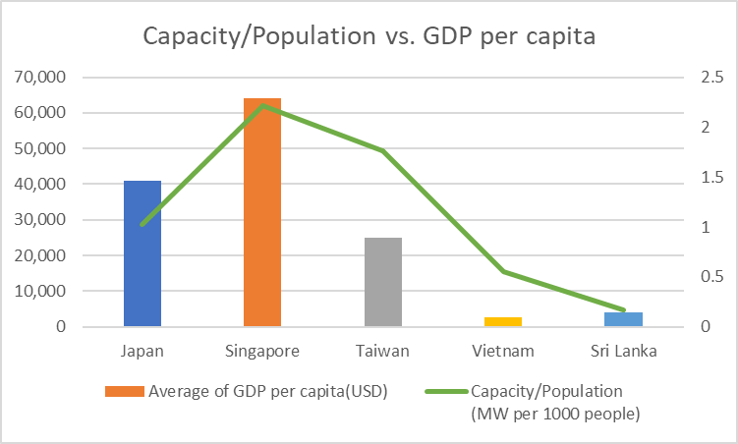
Findings
Findings
Which Country facing Shortage of Power Generating Capacity?
Question: 4. As Vietnam & Sri Lanka are still developing countries, currently they might not need as much Power Generating Rate as developed countries with respect to their Development Level. So, are they really in shortage of Power Generating Capacity in this stage? Which one has more market potential?
Answer:
Finding :
Developed Country: Already developed, Capacity already meet needs. Tend to cut down the Capacity, improve Transfer Rate
Developing Countries: Developing in speed, need more capacity to meet industry developing demand.
=>Compared to Sri Lanka, Vietnam have already built up enough Power Station to meet industry developing demand.
Hypothesis=> Shortage of Power Generating Capacity is restricting industry development in Sri Lanka

Slide 16
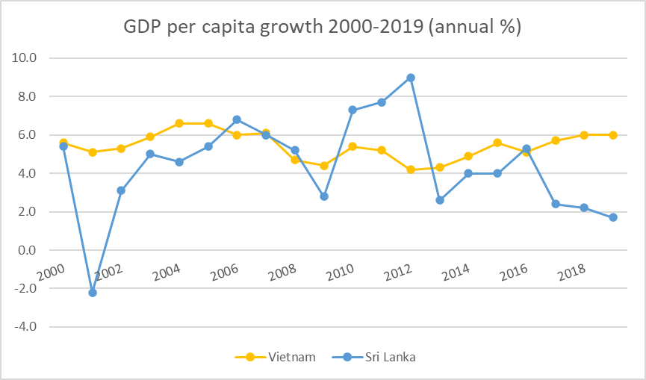
Findings
Findings
Which Country facing Shortage of Power Generating Capacity?
Hypothesis=> Shortage of Power Generating Capacity is restricting industry development in Sri Lanka
Question: 5. Is Sri Lanka developing well compared to Vietnam? What are their annual growth rate in GDP per capita?
Answer:
Finding :
Compared to Vietnam, the Developing Speed in Sri Lanka drops drastically in recent years.(2017-2019)
=> Shortage of Power Generating Capacity might be one of the reason restricting industry development in Sri Lanka.
=>Sri Lanka is badly in need of new Power Stations.
=>In short term, there will be more market potential in Sri Lanka.
<=Problem solved

Slide 17
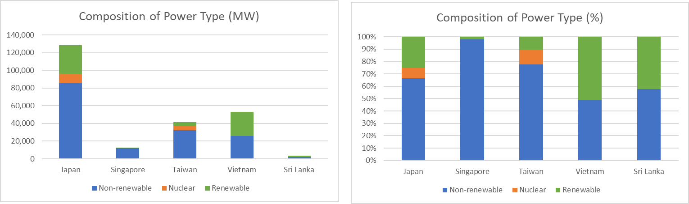
Findings
What’s more
Which field to step into?
Question: 6. What is the Composition of Power Type in these 5 countries? (i.e. Non-renewable/Nuclear/Renewable)
Answer:
Finding :
Developed Country: high composition in Non-renewable, Developing Countries have relatively high composition in Renewable
Developing Countries: Vietnam and Sri Lanka shares similar composition.(half-half)
=> Power Stations are built recently when world tends to be Renewable Energy.

Slide 18
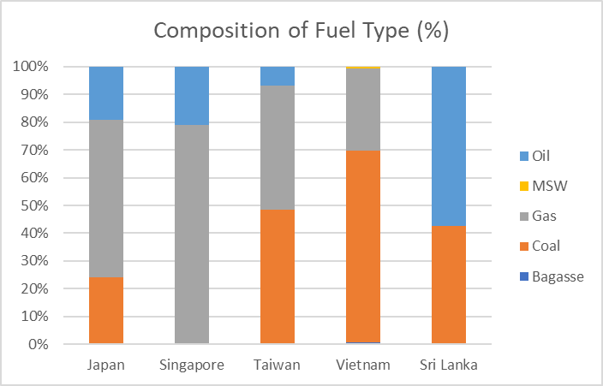
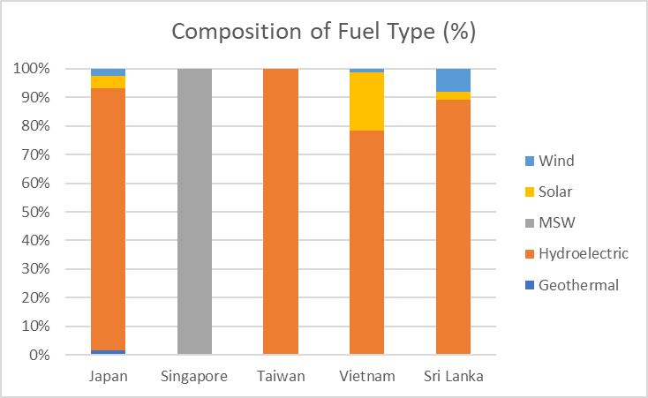
Findings
What’s more
Which field to step into?
Question: 7. What is the Composition of Fuel Type in these 5 countries? (Non-Renewable/Renewable)
Answer:
Non-Renewable
Renewable
Finding :
Vietnam: Non-Renewable: Short of Oil sources.
Renewable: Short of Wind.
Sri Lanka: Non-Renewable: Relies heavily on Oil, short of Gas (maybe due to lack of importing facility)
Renewable: Short of Solar.

Slide 19
Conclusion
Conclusion
Market Potential:
In short term, there will be more market potential in Sri Lanka.
In long term, There will be market potential in both Vietnam & Sri Lanka.
Field to step in:
In Vietnam, look more into Oil in Non-Renewable, Wind in Renewable
In Sri Lanka, look more into Gas in Non-Renewable, Solar in Renewable

Slide 20
Q & A
Q & A

Slide 21
Thank you!
Li Zheming

